Slide 1

Poem Dating
CSCI 374 Final Project
Simon Harris, Jiachen Liu, Will FK Tokunaga

Slide 2
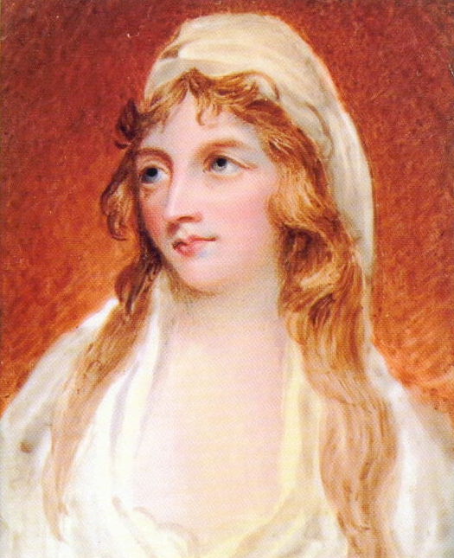
Yet still thy strings, in Fancy's ear,
With soothing melody shall play;
Thy silver sounds I oft shall hear,
To pensive gloom a silent prey.
Mary Tighe, 1811

Slide 3


Task
Given a poem, what century was it published in?

Slide 4
Motivation
We enjoy poetry and are interested in natural language processing
How much has poetry changed over the years?
What will our results tell us about the ways in which it has changed?
What do our results tell us about the best ways to do NLP?

Slide 5

Data
Collection of 4057 poems
Ranging from 17th, 18th, and 19th century (middle of the author’s life span)
Cleaned of punctuation
Source: https://github.com/chaimgluck/projects/tree/master/Project-poems

Slide 6
Methods
Traditional neural network with simple ANN and predefined features
Vectorize the words using embedding and run through
simple ANN
RNN,
LSTM
bidirectional LSTM
Support Vector Machine (SVM)
Naive Bayes

Slide 7
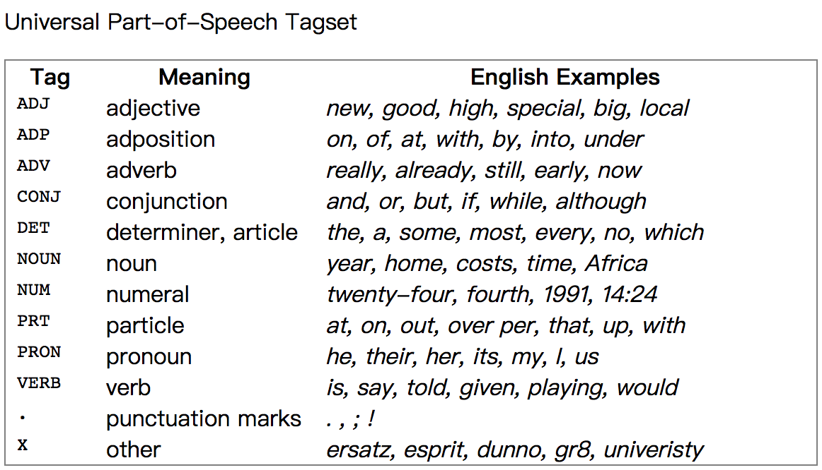
Attributes
Word Diversity
Poem Length
Average Word Length
Word Sentiment
Part of Speech Proportions
Nons, Verbs, Adj, Adv, etc.
https://www.nltk.org/book/ch05.html?fbclid=IwAR32NoYCE8WVfOahwcSFVnWtOYuGBi0dj8dU-PWrlQ4SyYFe1j2CUk8rIqE

Slide 8
Traditional ANN Results
Traditional ANN | Accuracy | C.I.
Using diversity, length, sentiment, POS tagging | 0.648 | [0.605, 0.691]
using with top 200 words freq proportion | 0.643 | [0.600, 0.687]
using top 2000 words freq proportion | 0.719 | [0.678, 0.760]
using relative frequency of all words (remove stopwords) (input_dim > 30000) | 0.789 | [0.752, 0.827]
using relative frequency of all words (remove stopwords and did stemming) | 0.74 | [0.700, 0.780]
using relative frequency of all words (with stopwords) | 0.73 | [0.690, 0.771]

Slide 9
Embedding (alternative to one-hot encoding)
mapping of categorical variable to a vector of continuous numbers (supervised learning algorithm)
Advantages
reduce the dimensionality
Maintain spatial relationship after transforming
Words associated with one category will be closer in transformed vector space
Words = [“ML”, “AI”, “Music”]
One hot: [[1,0,0]
[0,1,0]
[0,0,1]]
Embedding: [ [0.5, 0.8]
[0.6, 0.82]
[-0.5, -0.6] ]

Slide 10
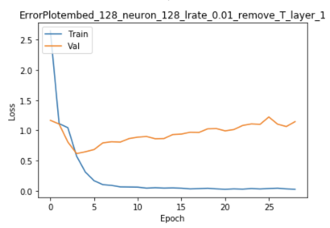
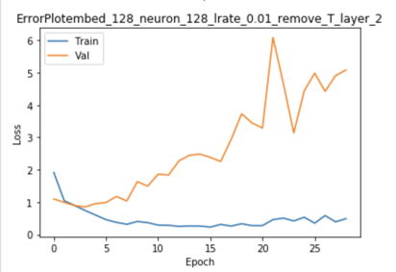
Word Embedding ANN
Accuracy | CI | Embedding | # Neurons | Learning Rate | Remove? | # hidden Layers | Drop out layers | Stemming?
0.69 | [0.65, 0.73] | 128 | 128 | 0.01 | T | 1 | 1 | F
0.65 | [0.61, 0.69] | 128 | 128 | 0.01 | T | 2 | 2 | F

Slide 11
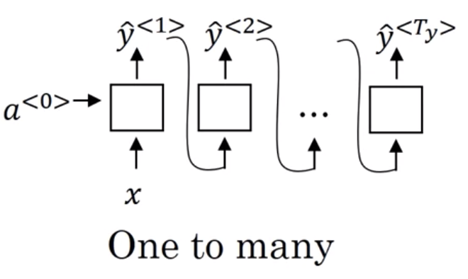
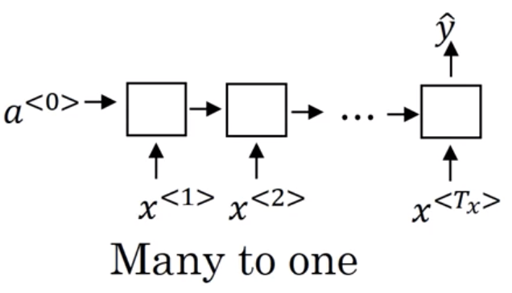
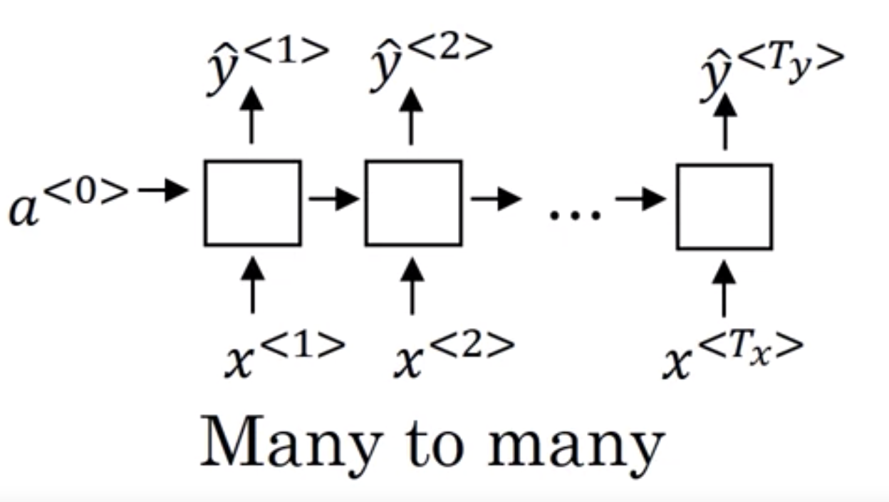
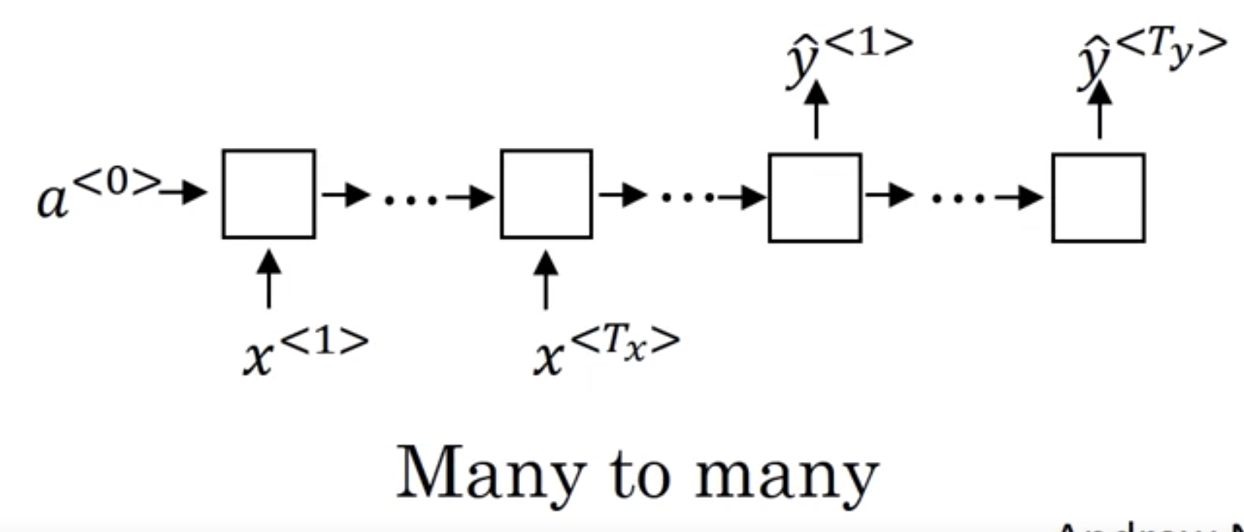
RNN architecture
https://www.coursera.org/learn/nlp-sequence-models/lecture/BO8PS/different-types-of-rnns
Sequence generation
Multi-class sequence classification
Position (in sequence) prediction
Encoder-decoder (machine translation)

Slide 12
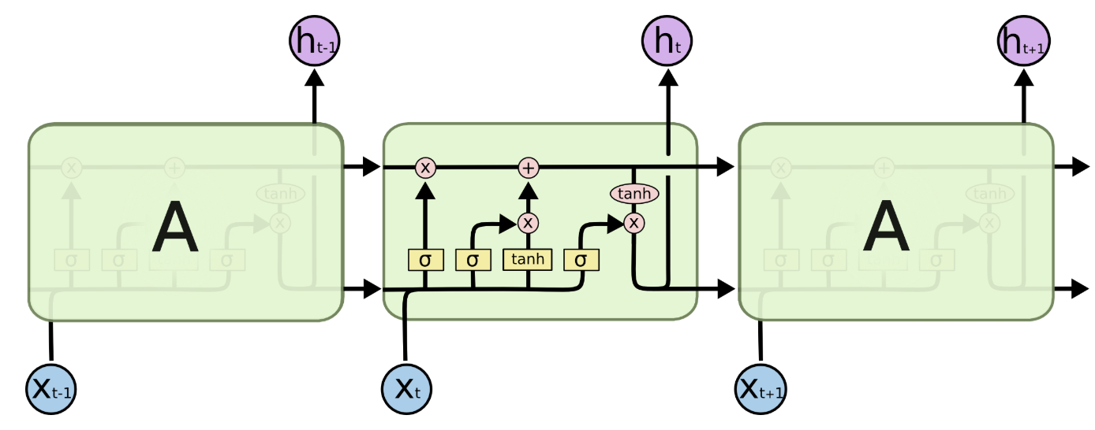
LSTM
https://colah.github.io/posts/2015-08-Understanding-LSTMs/
Avoids vanishing gradient problem in RNN

Slide 13
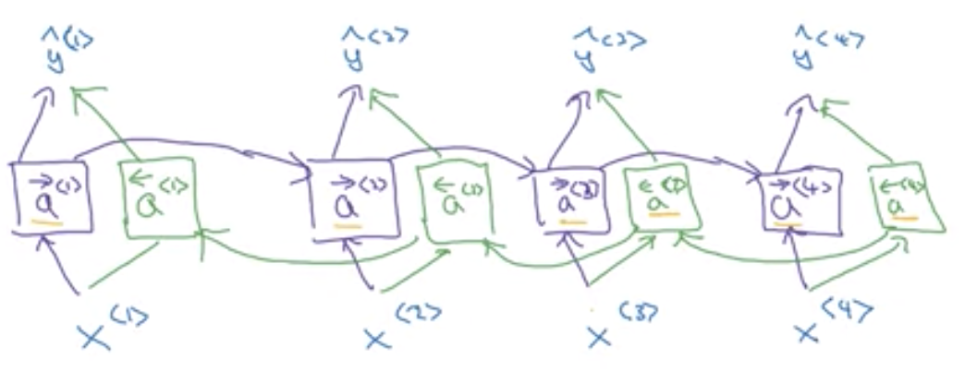
Bidirectional Architecture
https://www.youtube.com/watch?v=uRFegQXnY54
Takes both past and future info. Into account when making prediction

Slide 14
RNN Preliminary Results
Our RNN results haven’t been great so far
Need to test more hyperparameters
Accuracy | Confidence Interval | Embedding | # of neurons | Learning rate | # of hidden layers | # dropout layers
0.363 | [0.325, 0.402] | 512 | 512 | 0.01 | 1 | 1
0.337 | [0.301, 0.376] | 512 | 512 | 0.01 | 2 | 2
0.365 | [0.327, 0.403] | 512 | 512 | 0.01 | 3 | 3
0.368 | [0.330, 0.407] | 128 | 128 | 0.01 | 1 | 1

Slide 15
LSTM Results
Average accuracy: 0.368
Best hyperparameters: 512 embedding, 512 neurons, 0.01 learning rate
Number of layers didn’t seem to make a huge impact
Accuracy | Confidence Interval | Embedding | # of neurons | Learning rate | # of hidden layers | # of dropout layers
0.556 | [0.516, 0.595] | 512 | 512 | 0.01 | 1 | 1
0.64 | [0.605, 0.681] | 512 | 512 | 0.01 | 2 | 2
0.571 | [0.53, 0.61] | 512 | 512 | 0.01 | 3 | 3

Slide 16
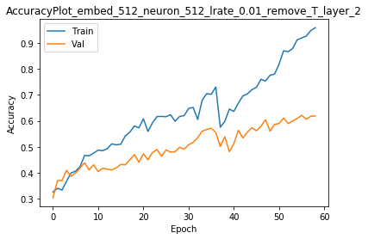
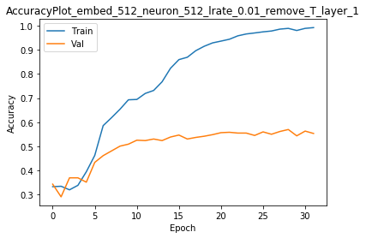
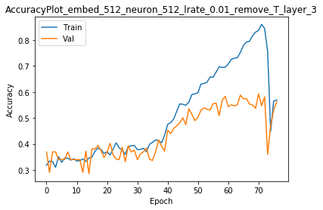
3 Best Results for lstm

Slide 17
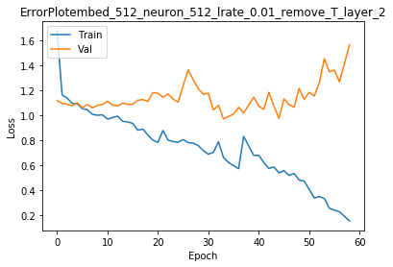
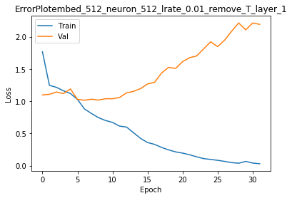
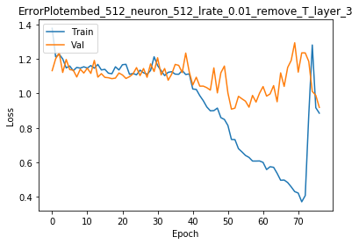
3 Best Results for lstm

Slide 18
Notable Bidirectional LSTM Results
Average accuracy: 0.701
Accuracy | CI | Embedding | # Neurons | Learning Rate | Remove stopwords? | # Layers | Drop out layers | Stemming?
0.722 | [0.686, 0.758] | 128 | 128 | 0.01 | T | 1 | 1 | F
0.66 | [0.622, 0.697] | 128 | 128 | 0.01 | F | 1 | 1 | F
0.676 | [0.639, 0.713] | 128 | 128 | 0.01 | T | 1 | 1 | T
0.7 | [0.662, 0.735] | 128 | 128 | 0.01 | T | 1 | 1 | F

Slide 19
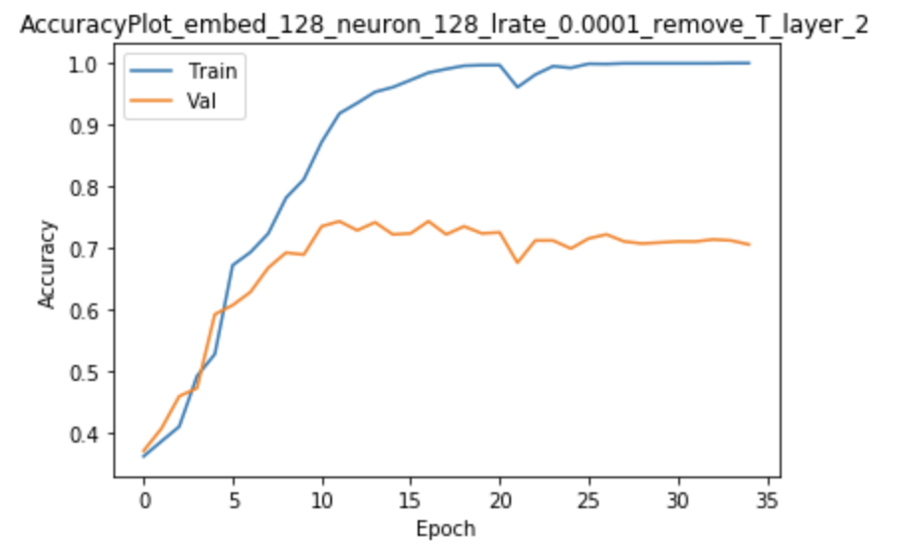
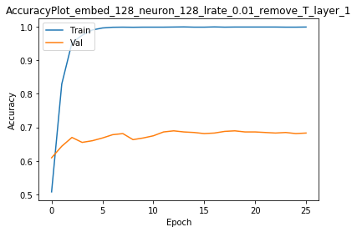
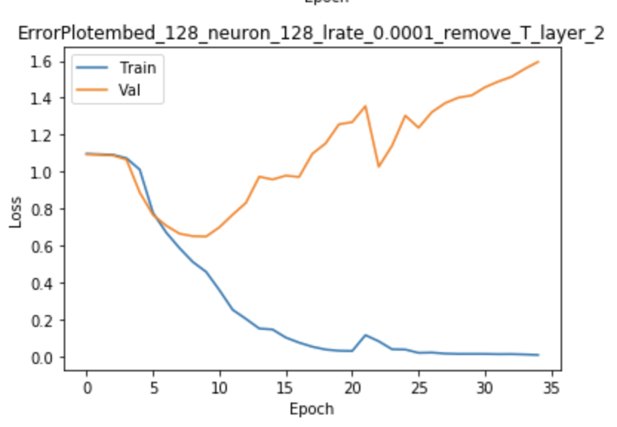
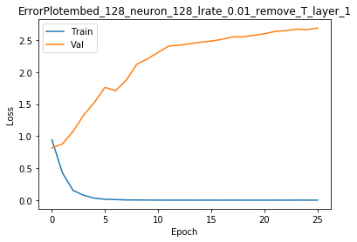
Bidirectional LSTM

Slide 20
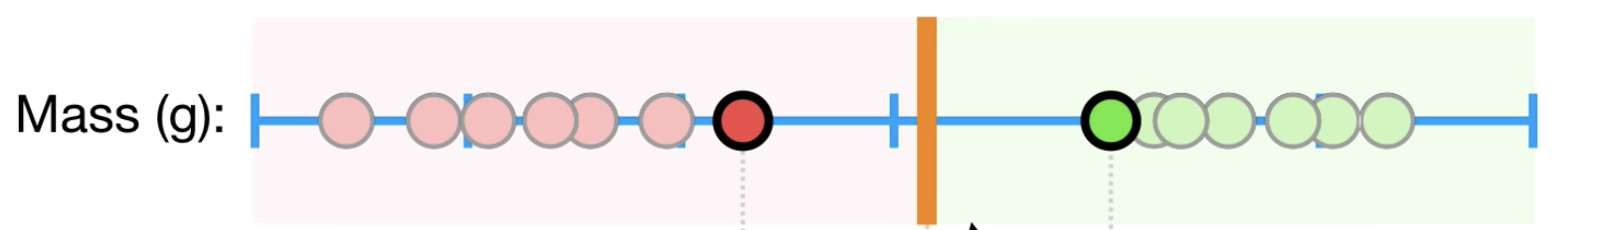
Support Vector Machine (SVM)
Find the best line/hyperplane that best separates the groups of data
https://www.youtube.com/watch?v=efR1C6CvhmE
https://en.wikipedia.org/wiki/Support-vector_machine

Slide 21
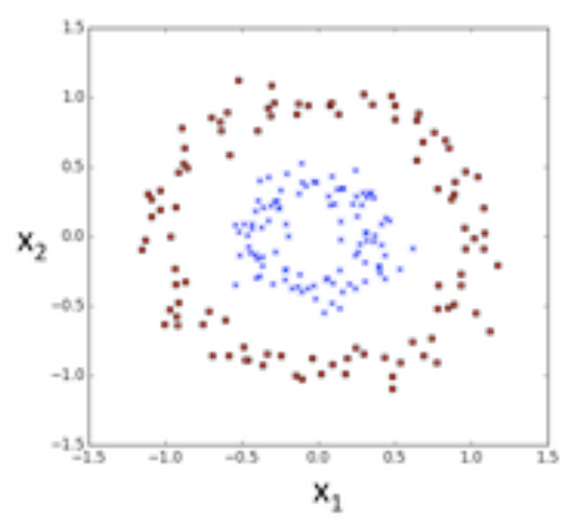
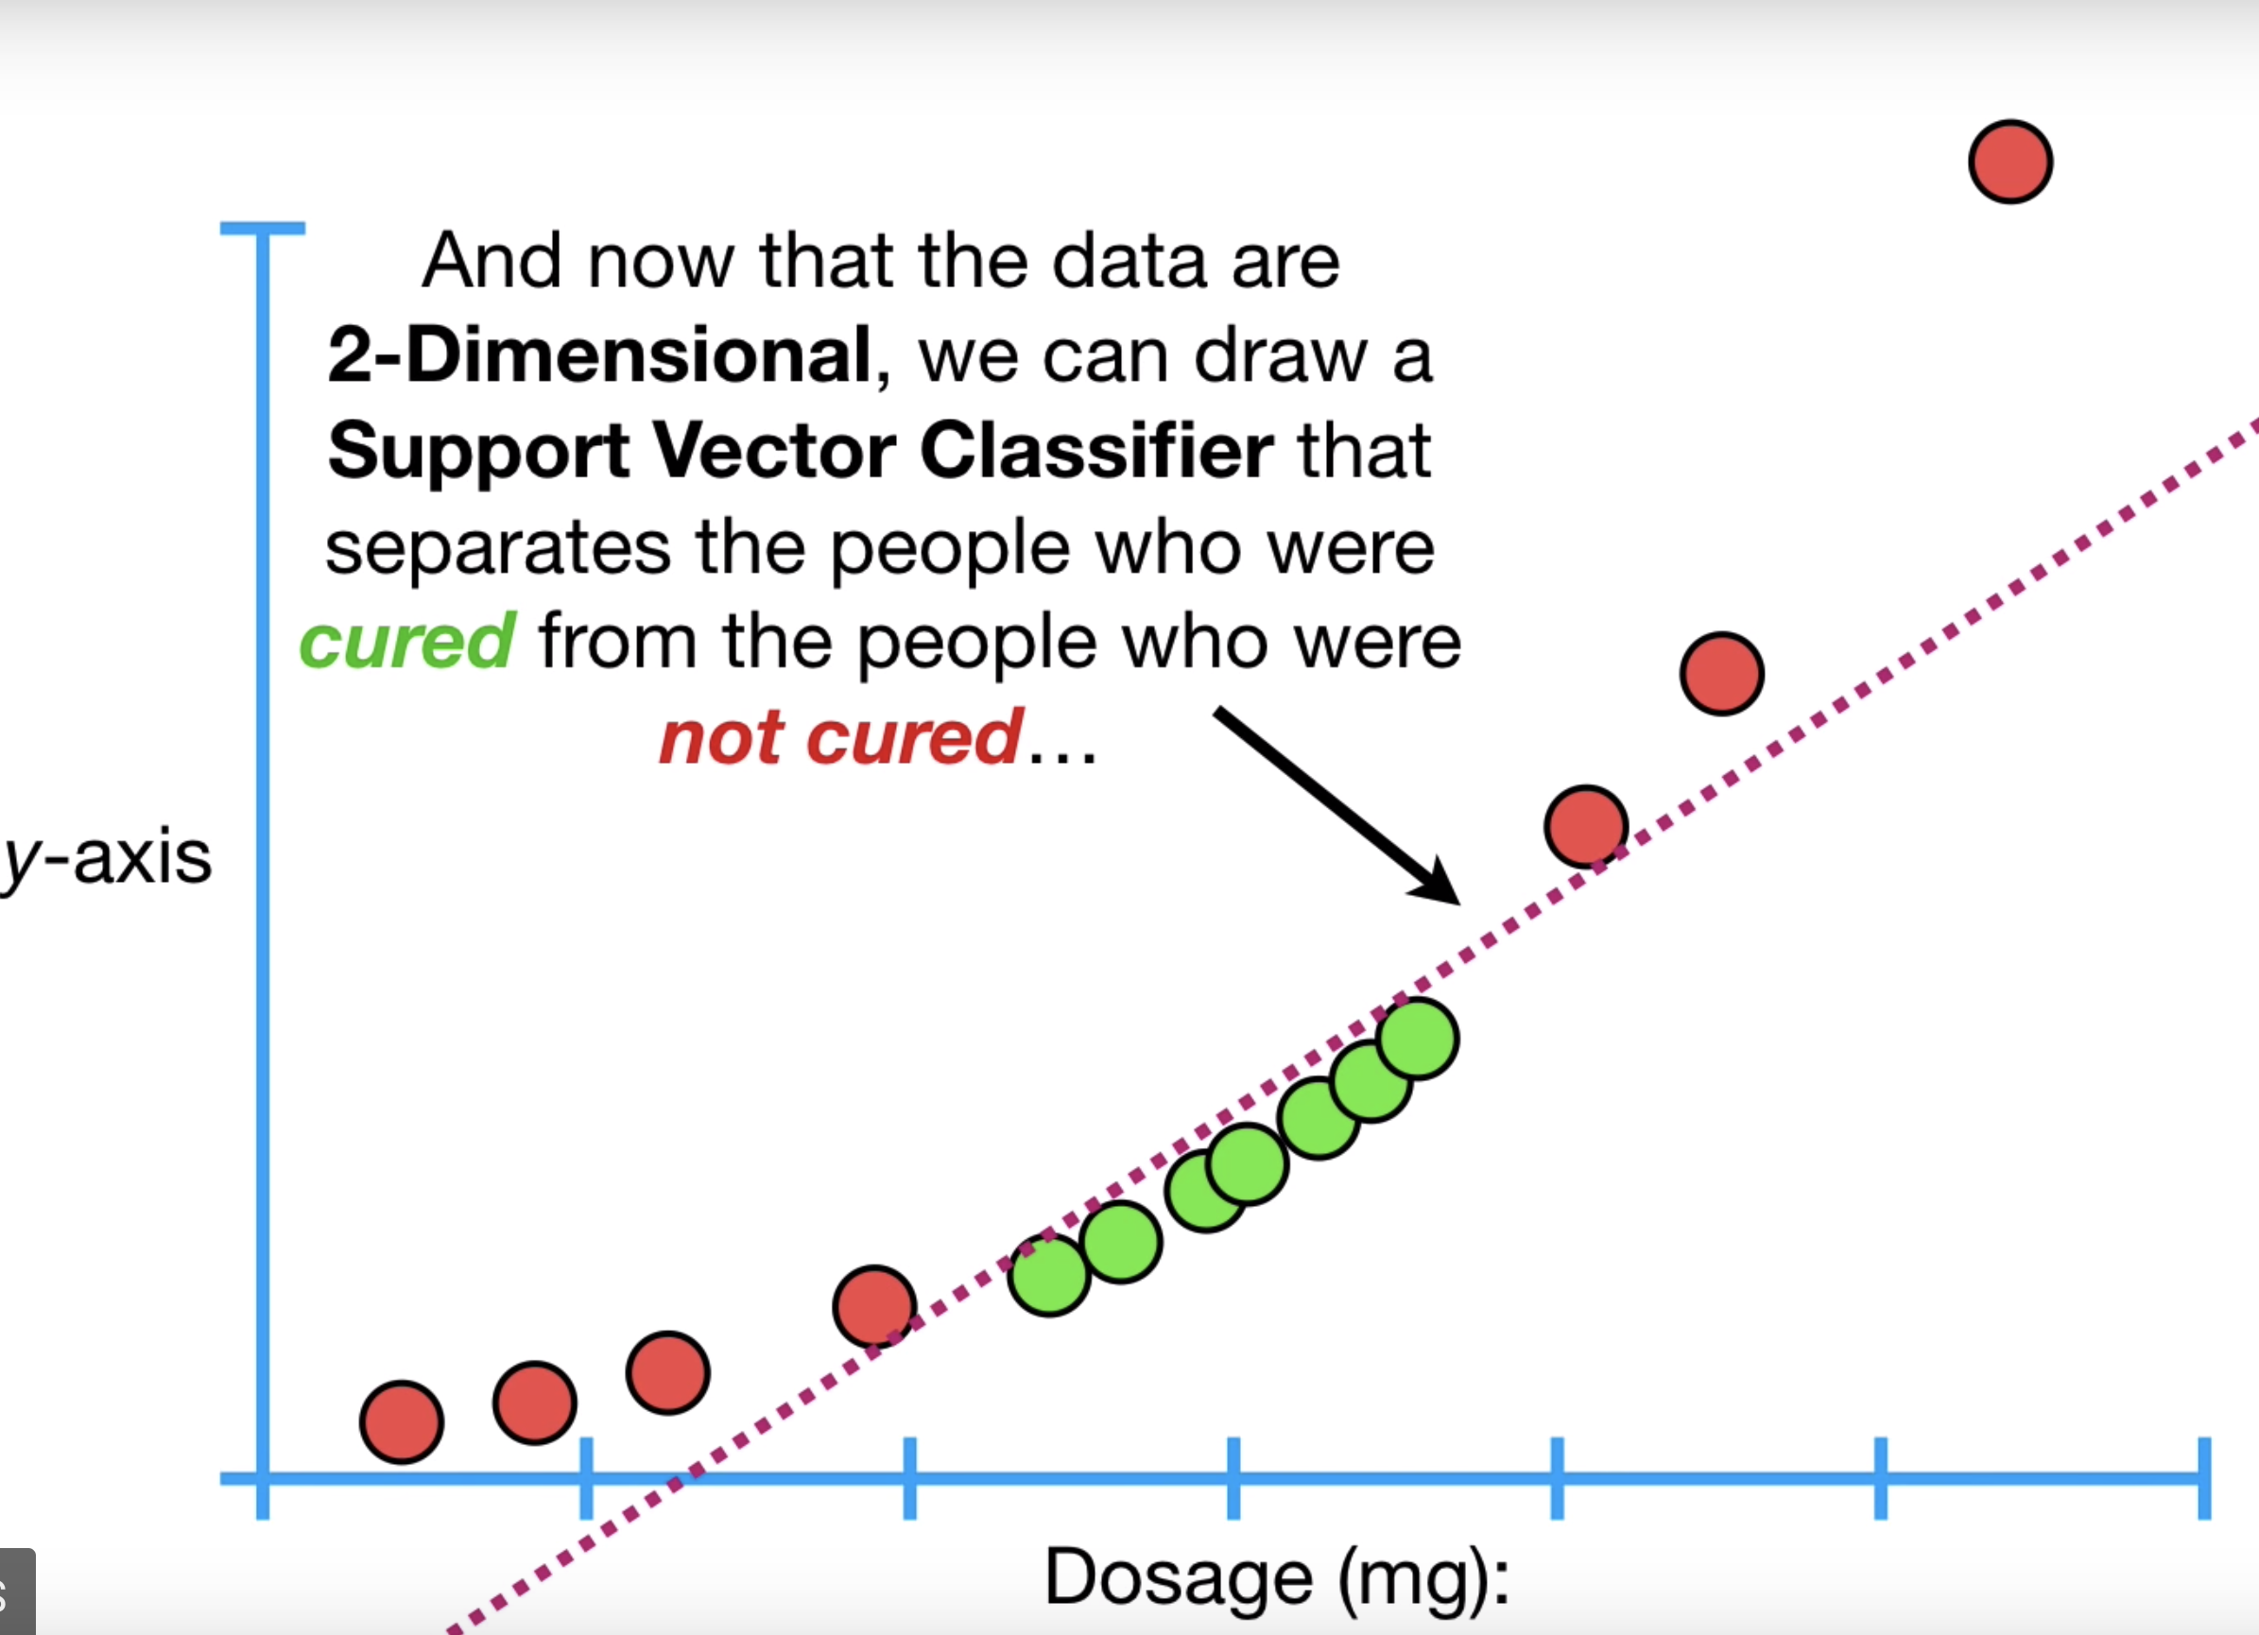
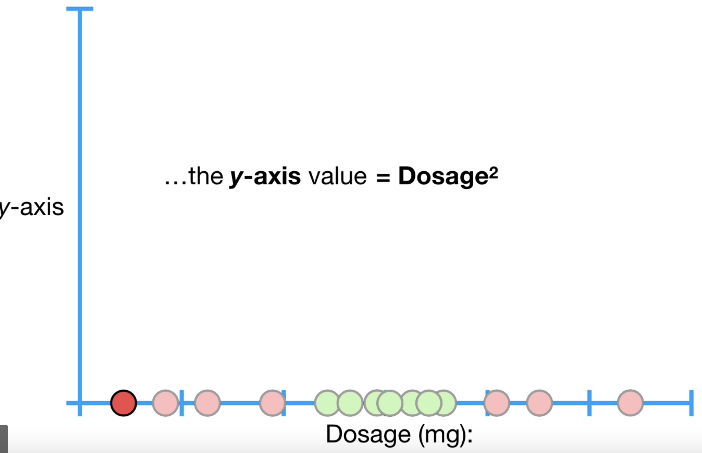
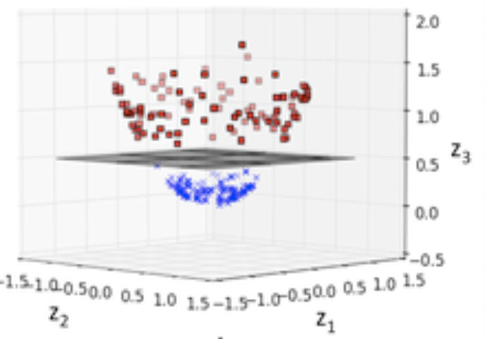
Nonlinearly Separable Cases
Kernel trick to elevate dimension
Linear kernel (no kernel)
Polynomial kernel
Radial kernel, etc.
https://www.youtube.com/watch?v=efR1C6CvhmE
https://www.kdnuggets.com/2016/06/select-support-vector-machine-kernels.html#:~:targetText=So%2C%20the%20rule%20of%20thumb,also%20a%20linear%20decision%20region.

Slide 22
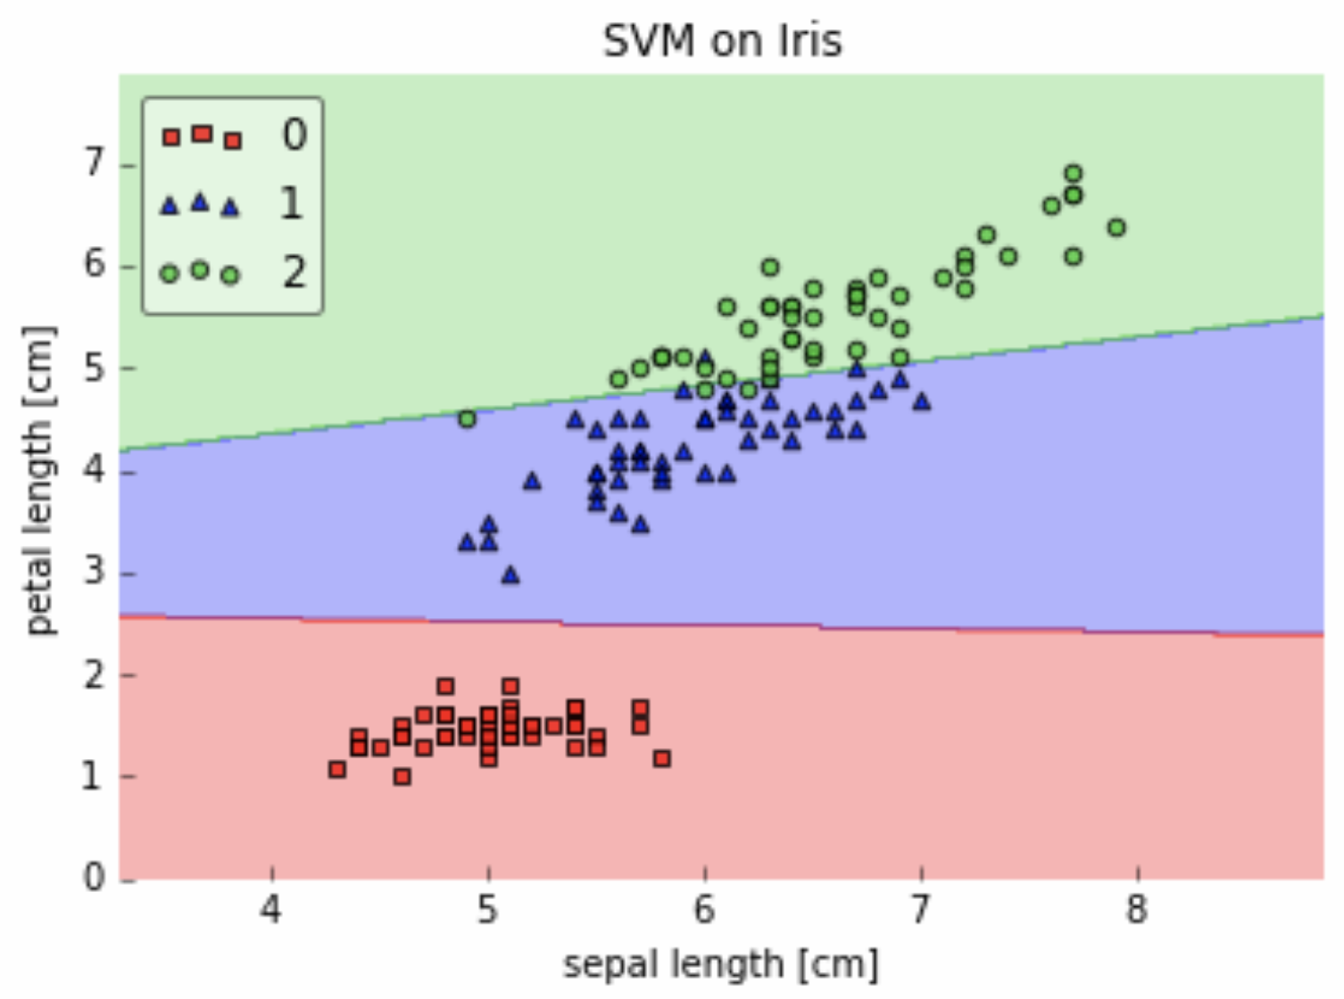
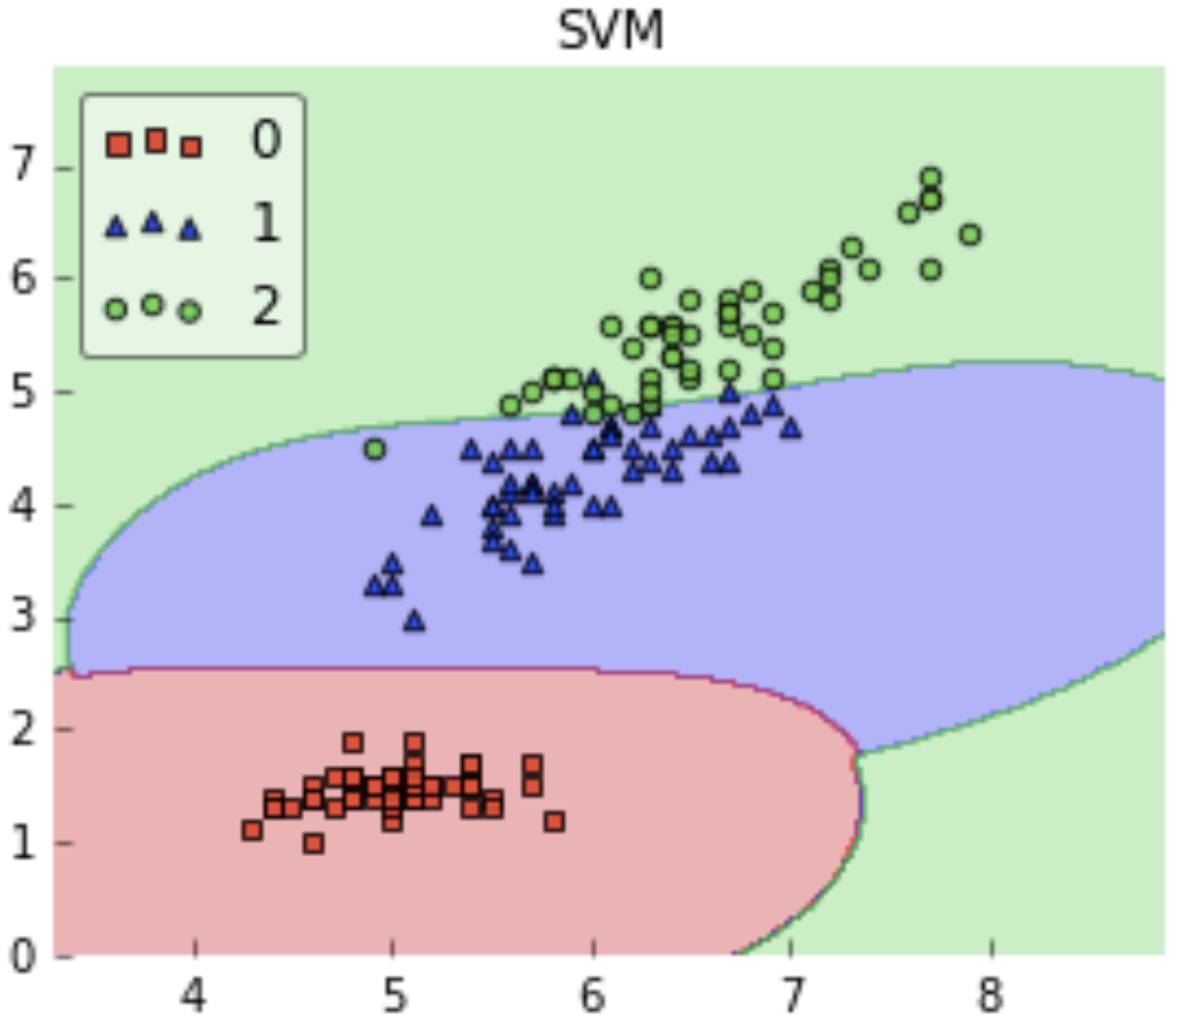
Choice of kernel
https://www.kdnuggets.com/2016/06/select-support-vector-machine-kernels.html#:~:targetText=So%2C%20the%20rule%20of%20thumb,also%20a%20linear%20decision%20region.
Linear Kernel
Radial Kernel

Slide 23
TF-IDF (term frequency-inverse doc. frequency)
Relative frequency of a word in a document weighted by the uniqueness of this word to this particular document
tf = # of times a word appears in a document / # of words in that document
Idf = log (total # of documents / # of documents containing this word)
Tf-idf = tf * idf
More common the word across documents -> idf closer to 0
Discount common words across documents
https://en.wikipedia.org/wiki/Tf%E2%80%93idf#:~:targetText=In%20information%20retrieval%2C%20tf%E2%80%93idf,in%20a%20collection%20or%20corpus.

Slide 24
SVM results
SVM (linear kernel) | Stemming | No Stemming
No stopword removal | 0.768, [0.745, 0.792] | 0.782, [0.759, 0.806]
Stopword removal | 0.777, [0.753, 0.800] | 0.783, [0.760, 0.806]

Slide 25
Naive Bayes Results
Average accuracy: 0.793
No combination significantly better than another
Naïve Bayes | Stemming | No Stemming
No stopword removal | 0.801, [0.769, 0.833] | 0.804, [0.773, 0.836]
Stopword removal | 0.775, [0.741, 0.808] | 0.791, [0.759, 0.823]

Slide 26
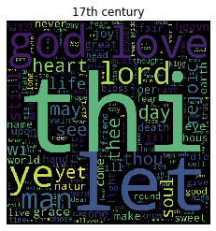
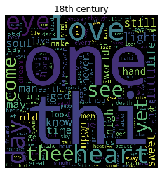
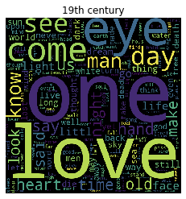
Word Cloud
More poems about lord in 17th 18th

Slide 27
Summary
Working models:
Traditional ANN with word frequency attributes (70%-80%)
Word embedding with ANN (65%-70%)
LSTM (55%-65%)
Bidirectional LSTM (70%)
Naive Bayes (80%)
SVM (78%)
RNN didn’t learn anything ….

Slide 28
Summary
Implications:
No effect of removing stop words and stemming on Naive Bayes (all words are independent, robust)
Removing stopwords increased performance for traditional ANN
Effect of # of hidden layers
Increasing layers causes less smooth gradient descent
2 hidden layers performed best for LSTM
Removing stopwords increased performance for bidirectional LSTM and stemming caused marginally decreased performance
Bidirectional LSTM significantly outperformed RNN and LSTM on this dataset
Architecture > hyperparameter tuning
Naive Bayes, traditional ANN and SVM with linear kernel achieved the best performance
Sometime simpler models work better!
Choice of word > style/structure

Slide 29

Challenges
Finding a poem dataset with enough corpus
Lack of line breaks and stanza breaks
Running our program takes a long time depending on hyperparameters

Slide 30
Future directions
Maybe try new attributes
bigrams or trigrams
Lexical stress (rhythmic pattern)
Test different kernels for SVM
Use K folds cross validation instead of single split
Test on other multiclass text classification datasets to examine whether the performance on RNN/LSTM is due the unrepresentative dataset

Slide 31
References
Alegría, I., Hulden, M., & Manex Agirrezabal. (n.d.). Machine Learning for Metrical Analysis of English Poetry. Retrieved from https://www.aclweb.org/anthology/C16-1074/.
https://scikit-learn.org/stable/modules/svm.html
https://www.kdnuggets.com/2016/06/select-support-vector-machine-kernels.html#:~:targetText=So%2C%20the%20rule%20of%20thumb,also%20a%20linear%20decision%20region.
https://github.com/chaimgluck/projects/tree/master/Project-poems
https://www.nltk.org/book/ch05.html?fbclid=IwAR32NoYCE8WVfOahwcSFVnWtOYuGBi0dj8dU-PWrlQ4SyYFe1j2CUk8rIqE
https://www.coursera.org/learn/nlp-sequence-models/lecture/BO8PS/different-types-of-rnns
https://colah.github.io/posts/2015-08-Understanding-LSTMs/
https://www.youtube.com/watch?v=uRFegQXnY54
https://www.youtube.com/watch?v=efR1C6CvhmE
https://en.wikipedia.org/wiki/Support-vector_machine
https://en.wikipedia.org/wiki/Tf%E2%80%93idf#:~:targetText=In%20information%20retrieval%2C%20tf%E2%80%93idf,in%20a%20collection%20or%20corpus.

